Slide 1
ASYNC/AWAIT IN JAVASCRIPT

Slide 2

INTRODUCTION
When you start your computer, you see the Windows boot logo animation. While the animation is playing, your computer is performing various tasks like loading drivers, initializing components, and more. These tasks are asynchronous because they occur in the background while the animation
is being shown.

Slide 3
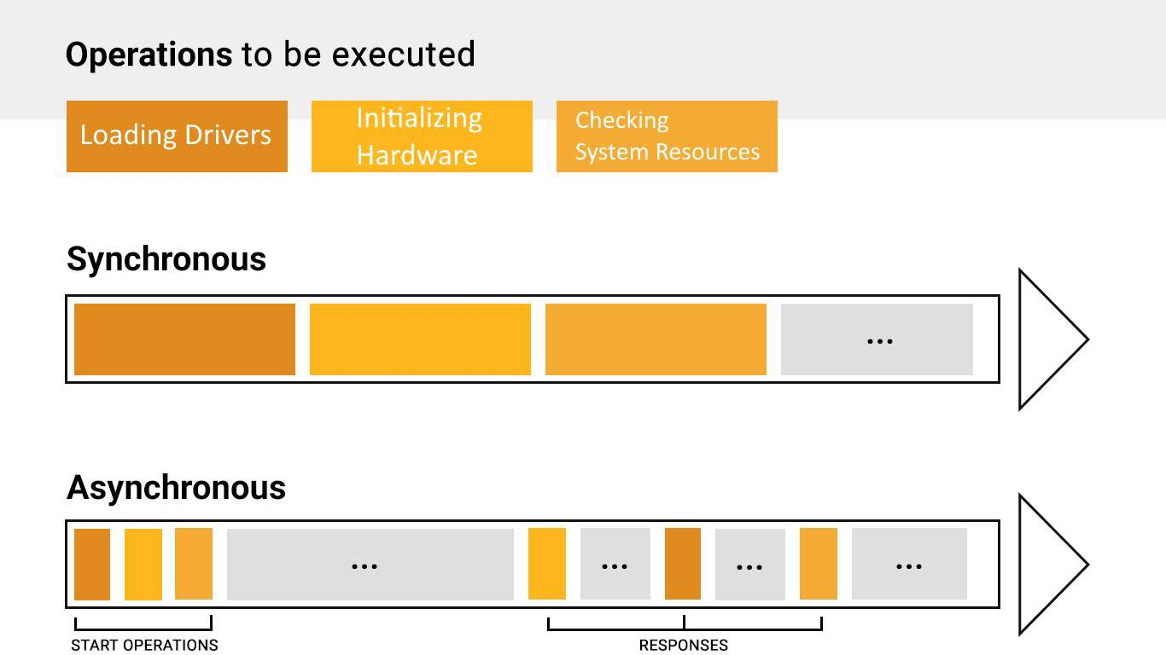
WHAT IS ASYNCHRONOUS PROGRAMMING?
In programming, tasks can be either synchronous or asynchronous. Synchronous tasks happen sequentially, one after the other. Asynchronous tasks, on the other hand, don't block the program's execution while they're being processed. Instead, the program can continue with other tasks and be notified when the asynchronous task is complete.

Slide 4
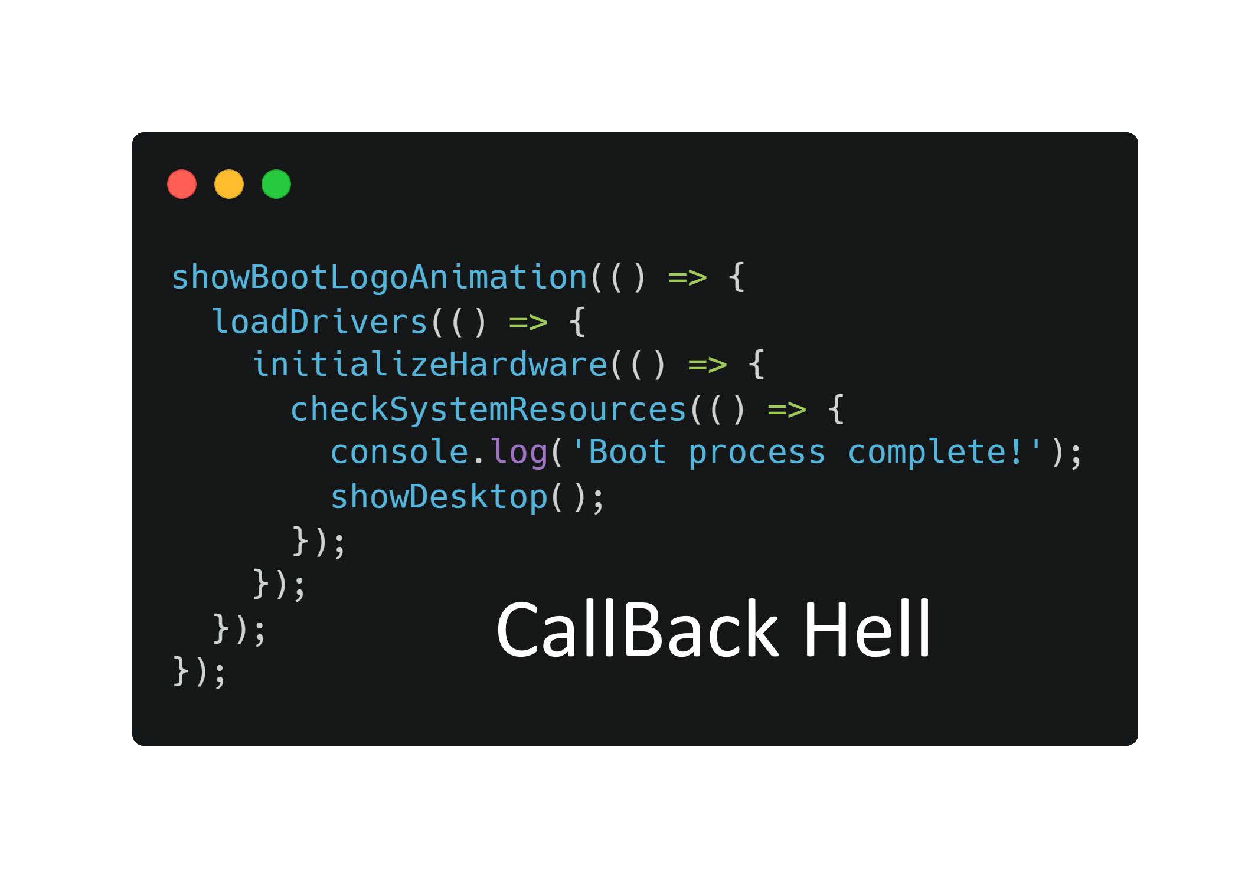

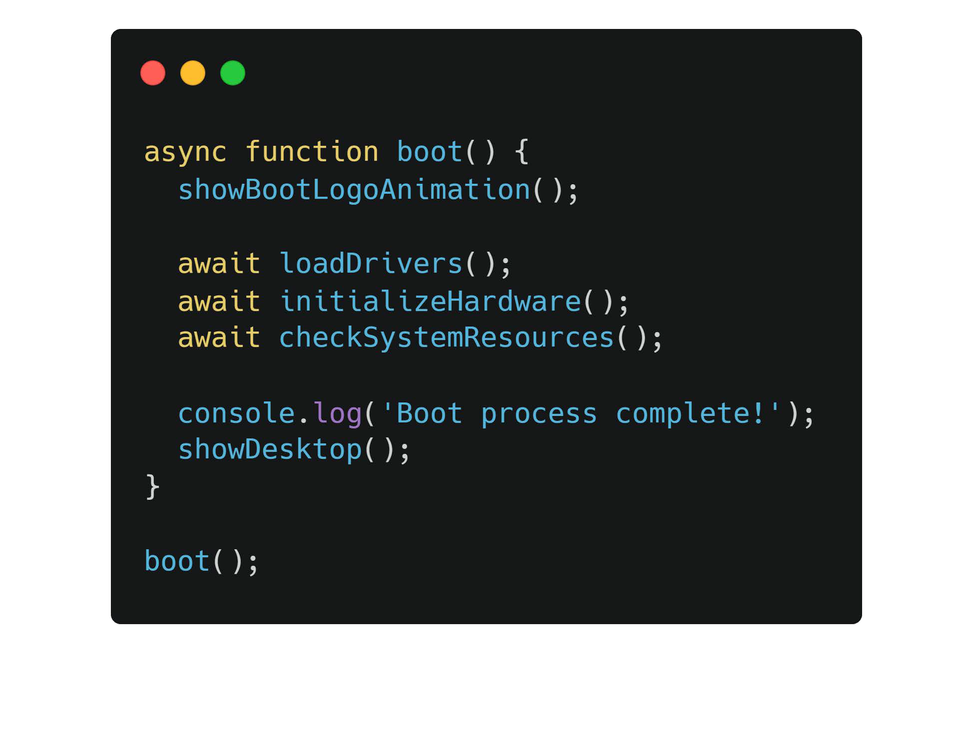

ASYNC/AWAIT
In JavaScript, handling asynchronous operations used to
involve using callbacks, which could lead to nested and
complex code structures, often referred to as "callback hell." To simplify this, the async/await syntax was introduced
Async functions are special functions that allow you to use the await keyword within them. The await keyword can be used to pause the execution of an async function until a promise is resolved. Promises are a way to handle asynchronous operations and represent a value that might be available now, in the future, or never.

Slide 5
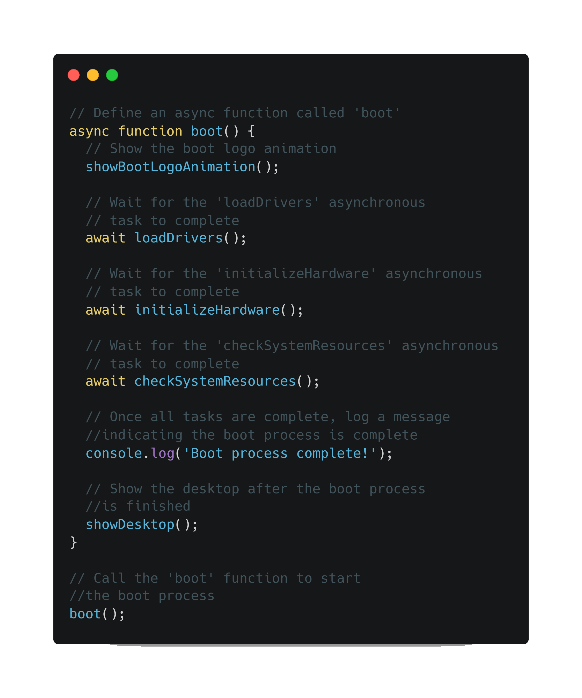
USING ASYNC/AWAIT
We will use the Windows boot logo as example, the animation of the boot logo is similar to the synchronous part of your code. Meanwhile, the asynchronous tasks are like the OS tasks that happen in the background.
With async/await, you can pause the execution of your code (like waiting for the tasks to complete) without blocking the main thread.

Slide 6
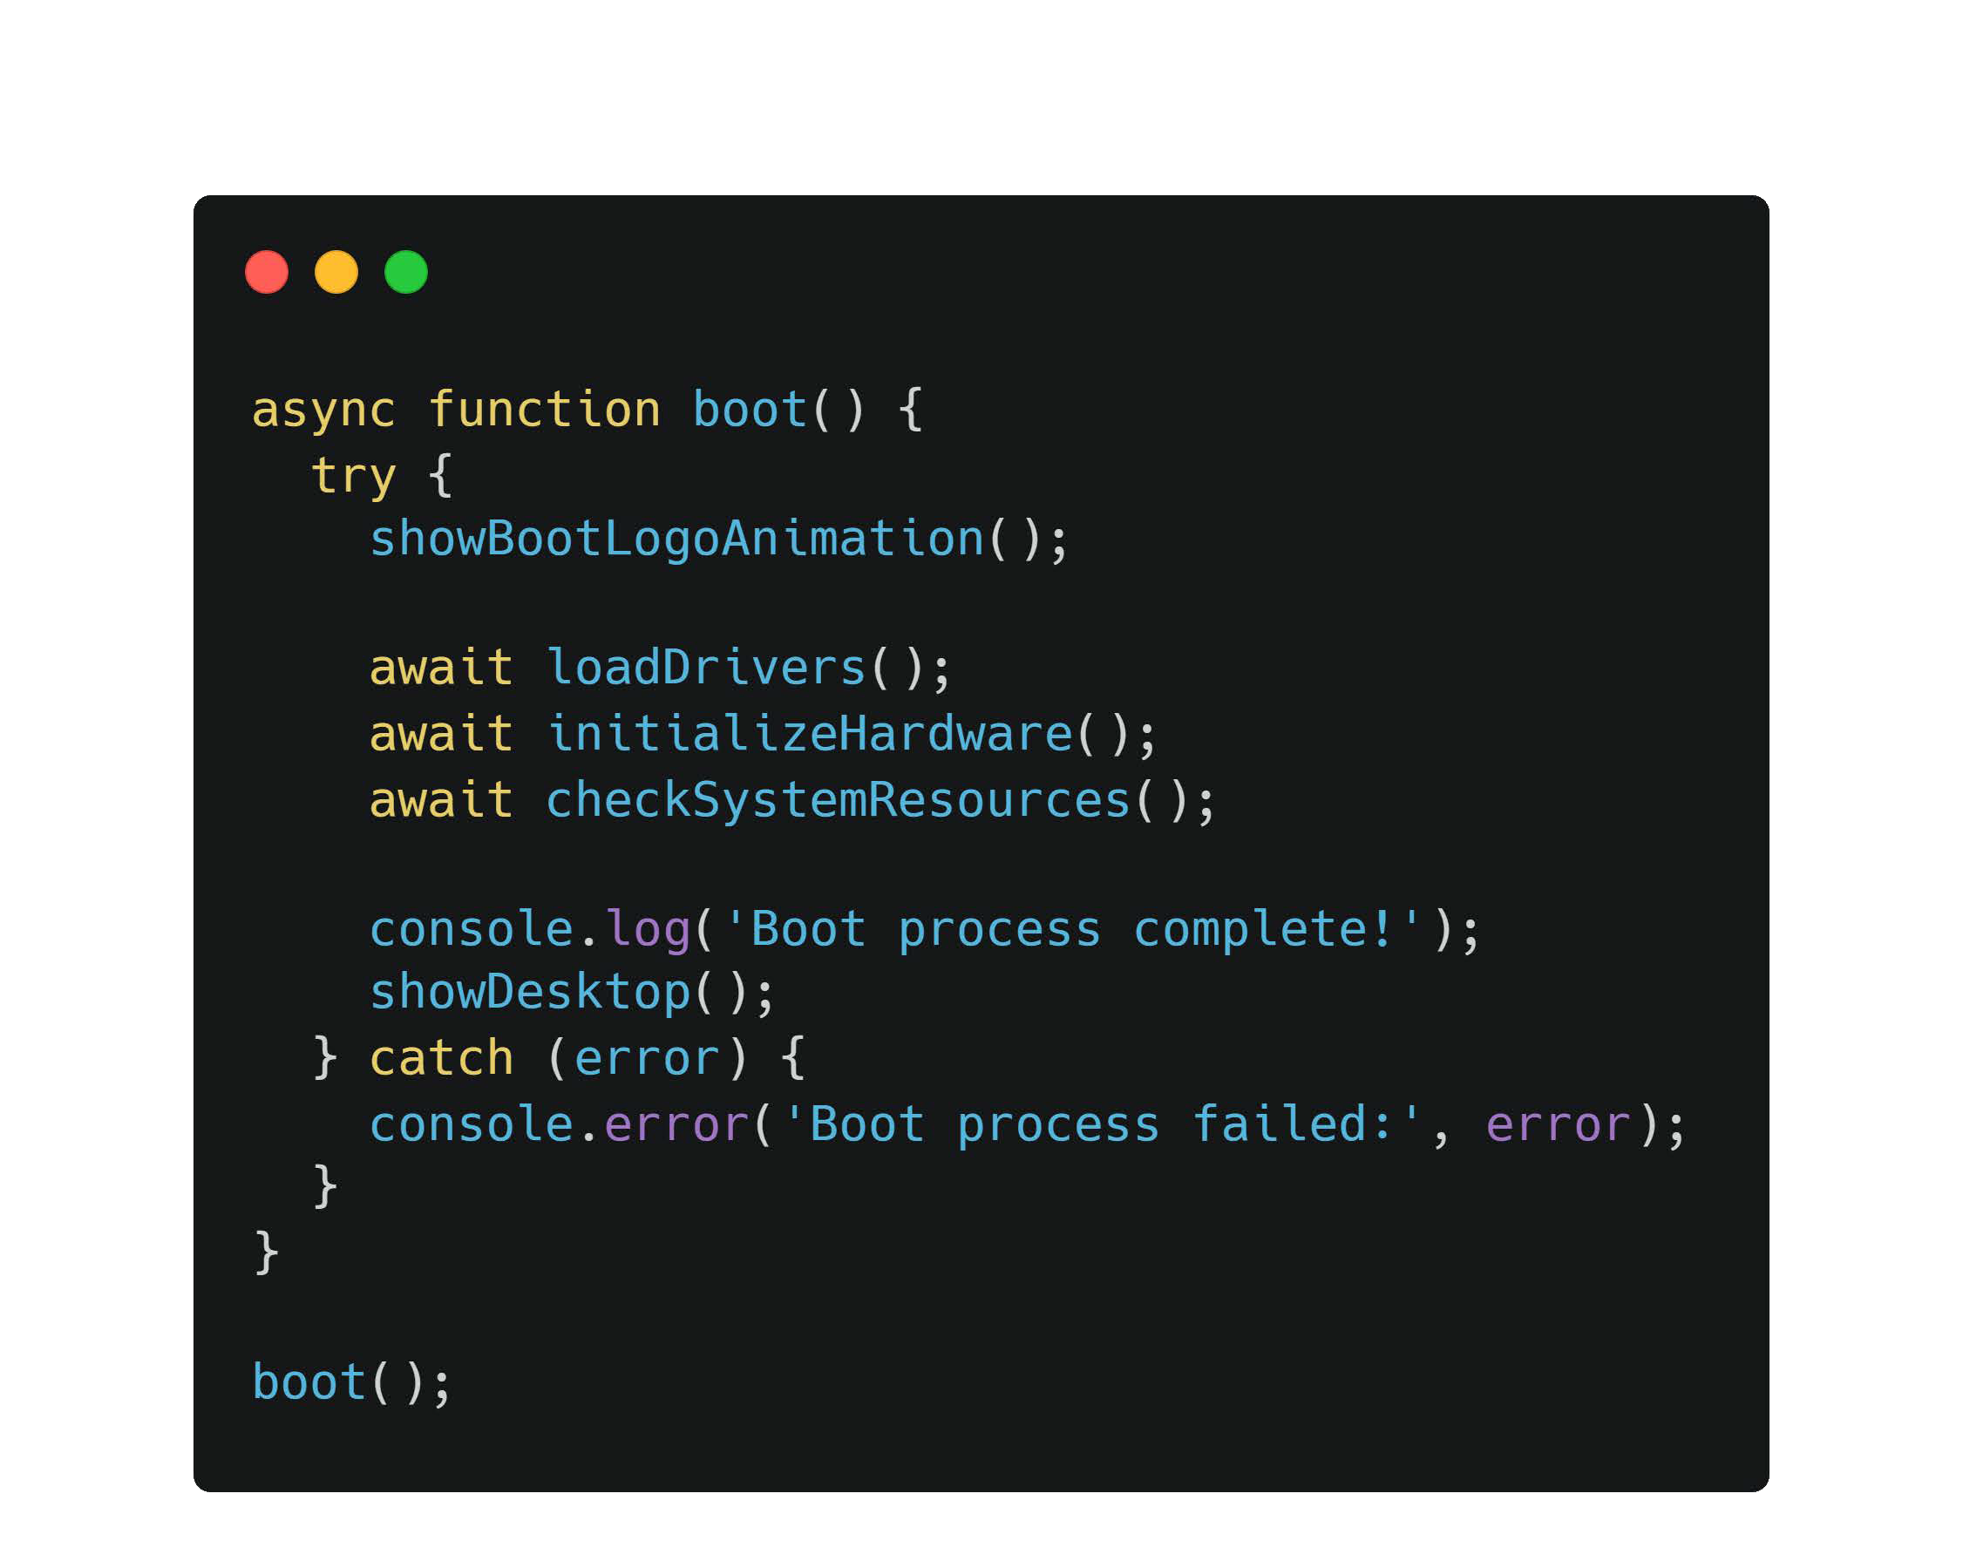
PROS OF ASYNC/AWAIT IN JAVASCRIPT
1- Readability and Simplicity: async/await makes asynchronous code look and behave more like synchronous code, making it easier to read and understand.
2- Handling: try...catch can be used with await, making error handling more intuitive and centralized.

Slide 7
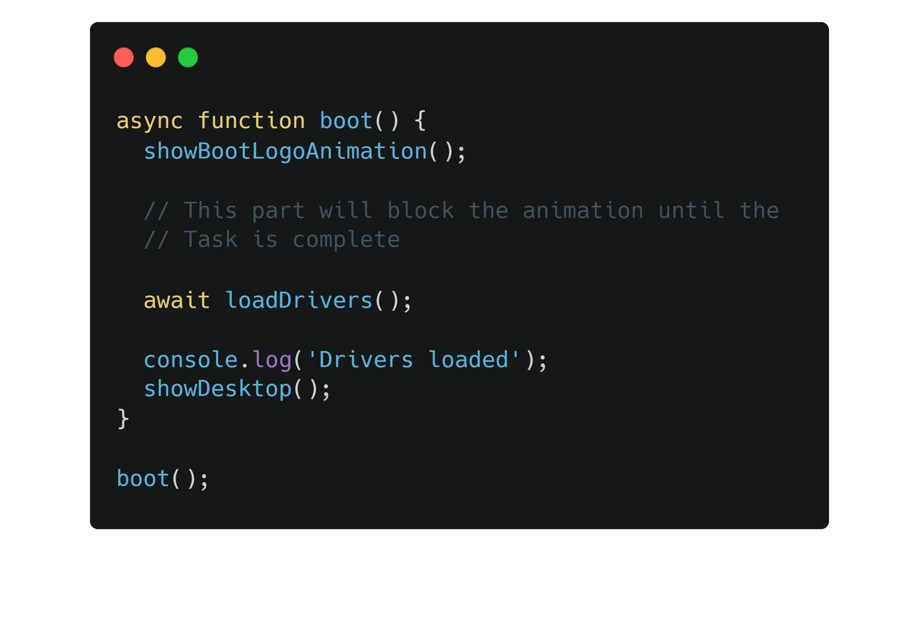
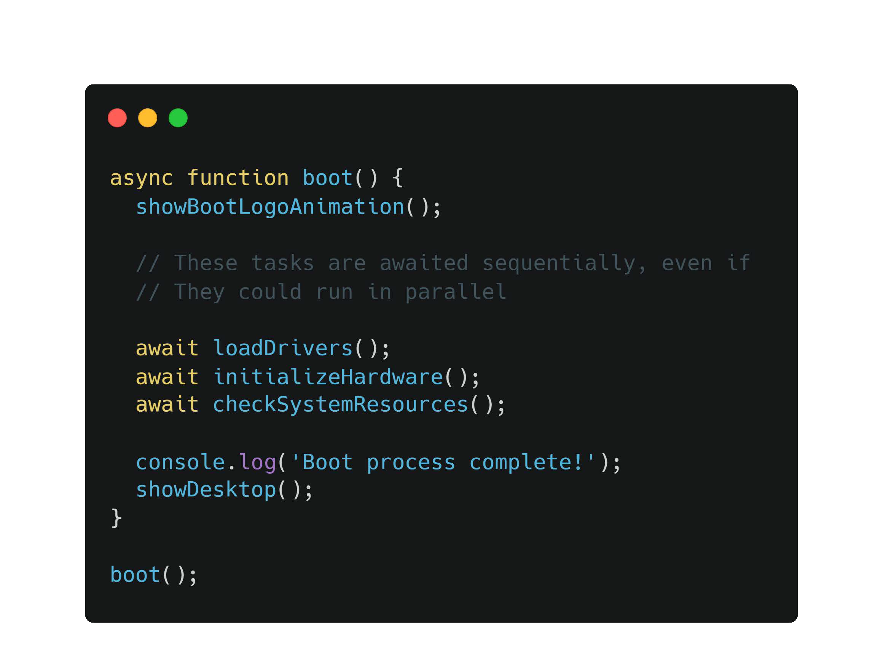
CONS OF ASYNC/AWAIT IN JAVASCRIPT
1 - Blocking Behavior: While awaiting an asynchronous operation, the execution of the function is paused, potentially blocking other asynchronous operations.
2 - Limited Parallelism: await makes asynchronous tasks run sequentially by default, which might not take full advantage of multi-core processors.

Slide 8
CONCLUSION
In conclusion, async/await is a powerful feature in JavaScript that has revolutionized the way we handle asynchronous operations. It addresses the challenges of callback hell and enhances code readability and maintainability. By allowing asynchronous code to resemble synchronous code, developers can focus more on the logical flow of their programs rather than managing complex callbacks or chaining promises.

Slide 9
Thanks!
Do you have any questions?

